Slide 1
Fantasy Football Data Viewer
Ryan Parlin

Slide 2
Program
The program is a UI interface for a series of data for (daily) fantasy football
The data was scraped from ESPN by a Python script that I had previously developed
The interface is a Universal Windows Platform app
The data sources are flat (JSON) files.

Slide 3
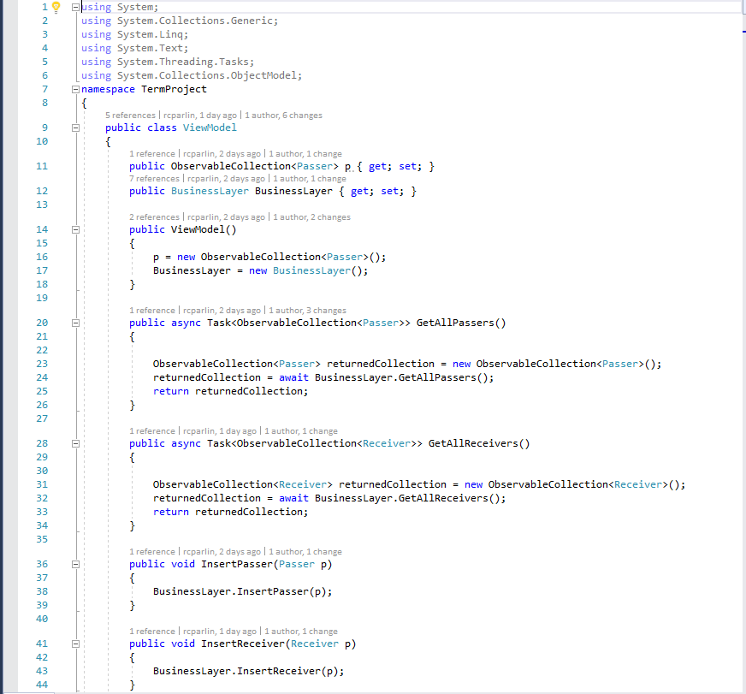
Architecture
Since the project was written as a UWP app, it followed that the Model-View-ViewModel approach would work well for this project
However, the viewmodel ended up being merely a wrapper for the business logic layer

Slide 4
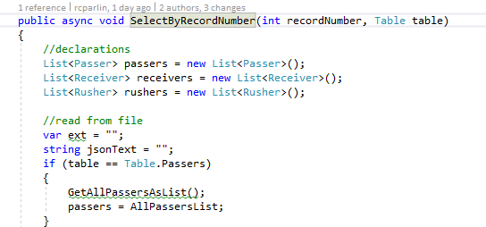
Repository Layer
The applications repository layer contains methods to execute the CRUD operations

Slide 5
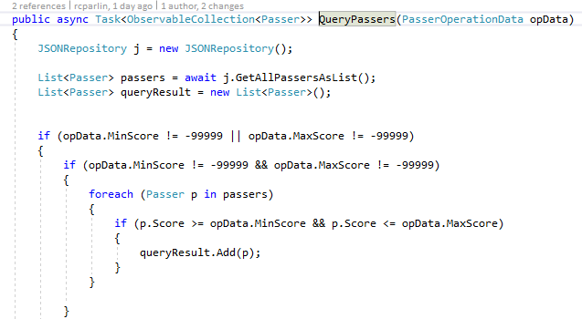
Business Logic Layer
The application’s business logic layer contains methods that were not strictly CRUD operations and needed them to execute their tasks.
The query and sort methods are in this layer

Slide 6
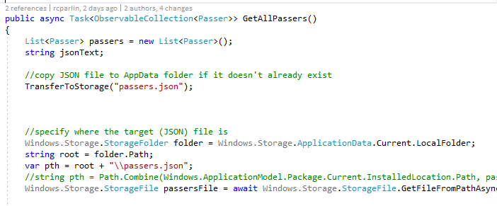
Asynchronous Programming
Since this application was a UWP project, the file IO methods available to this subset of the .NET framework are asynchronous to support devices with fewer system resources than a typical workstation.
This means that file IO heavily employed the following:
The async and await keywords (from C# 5)
Tasks (used for returning types from asynchronous methods)
To use async/await, async needs to be in the method definition.
Async also needs to be used throughout the call stack otherwise one of the calls will hang.

Slide 7
ObservableCollection<T>
This collection is similar to a list, but is designed for use with XAML
Observable collections implement the INotifyCollectionChanged and INotifyPropertyChanged interfaces, so I do not have to write my own events for updating the value of these collections -- it’s handled automatically.
Observable collections do not have as much functionality as List<T>, so I could not use one for the application’s internal data representation.

Slide 8
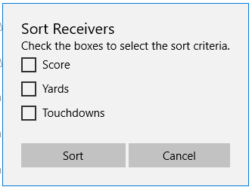
Dialog Boxes
User input in this application is handled through dialog boxes (the ContentDialog class)
The more complex dialog boxes were designed in the XAML for each page
The simpler dialog boxes were created programmatically in the code-behind

Slide 9
Next Version
Move more of the display logic into the viewmodel – right now, it’s all in the click events that handle dialog boxes
Add the Rusher page, the final type I was going to use
Include a function to predict future performance based on past performance

Slide 10
Remarks
Was it worth doing this project in UWP?
Windows Forms would have likely saved me a good deal of time
On the other hand, Microsoft is supposedly putting its resources into advancing UWP going forward
Windows 10 Fall Creators Update gives UWP access to System.Data, which makes it much easier to connect to remote databases (the data source I originally was going to use)
Prior to this, UWP apps needed a service to connect to a non-SQLite database (that is, a remote one)
I had to develop for Windows 10 Anniversary Update
Another reminder to keep minimum viable product in mind (although I did better at it this time)

